Slide 1
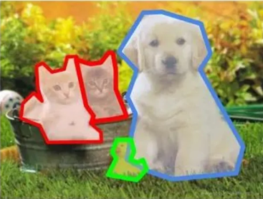
SESSION 11
Image
Segmentation
From semantic per-pixel labels to per-object masks
Instance segmentation — per-object masks
TYPE
COVERS
Theory + Hands-On
Semantic + Instance
Phase 3 — Core CV Tasks | Week 8

Slide 2
Today's Agenda
ROADMAP
What is Segmentation?
Three Flavours
1
2
Per-pixel classification, real-world tasks
Semantic vs Instance vs Panoptic
FCN — Fully Convolutional
U-Net Architecture
3
4
From classification CNN to dense prediction
Encoder–decoder + skip connections
Mask R-CNN
YOLOv8-seg & Hands-On
5
6
Two-stage instance segmentation
One-stage instance seg + Ultralytics quickstart
Session 11 | Image Segmentation | Phase 3 — Core CV Tasks

Slide 3
Recap: CV Task Hierarchy
RECAP
Classification
Detection
Semantic Seg.
Instance Seg.
"What is in
the image?"
"What &
where?"
"Which class
is each pixel?"
"Which object
owns this pixel?"
OUTPUT
OUTPUT
OUTPUT
OUTPUT
One label per image
Box + label per object
Per-pixel class map (no IDs)
Per-pixel + instance ID
dog (0.97)
dog, bike, truck
pixel-wise mask
dog1, dog2 separate
Each step adds spatial precision: image → boxes → pixel classes → object identity
Session 11 | Image Segmentation | Phase 3 — Core CV Tasks

Slide 4
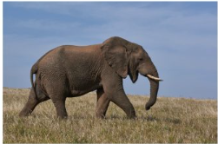
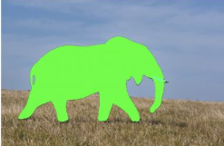
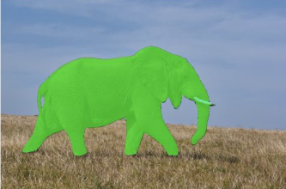
What is Image Segmentation?
DEFINITION
IMAGE
MASK
Pixel-Wise Classification
Assign a class label to every pixel of the input image.
Input
RGB image (H × W × 3)
Output
Mask (H × W) — class ID per pixel
OVERLAY
Goal
Match a ground-truth mask exactly
Hard?
Yes — boundaries, occlusion, scale variance
Session 11 | Image Segmentation | Phase 3 — Core CV Tasks

Slide 5
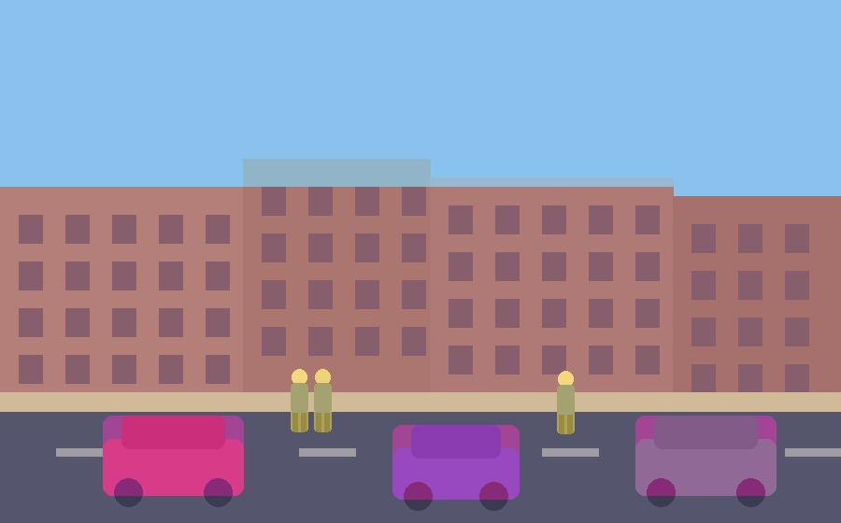
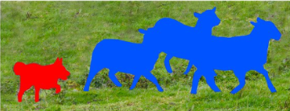
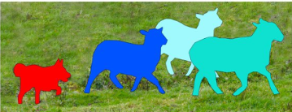
Three Flavours of Segmentation
TAXONOMY
Semantic
Instance
Panoptic
Class per pixel
Class + object ID
Best of both
All sheeps share one colour
Pixels labelled by category
No object identity
Ex: U-Net, FCN, DeepLab
Each sheep gets its own mask
Counts objects too
Ignores stuff (sky, road)
Ex: Mask R-CNN, YOLOv8-seg
Things → instance masks
Stuff → semantic regions
Unified single label map
Ex: Mask2Former, Panoptic FPN
Note: Panoptic blends both — "things" (countable objects) get instance masks; "stuff" (road, sky) gets semantic regions.
Session 11 | Image Segmentation | Phase 3 — Core CV Tasks

Slide 6
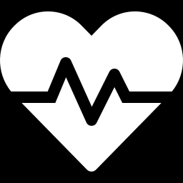
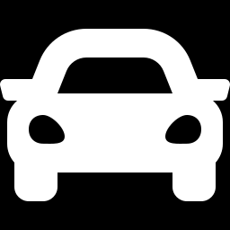
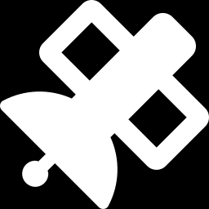
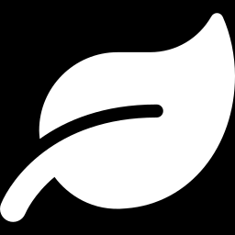
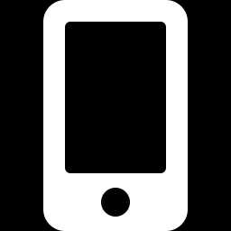
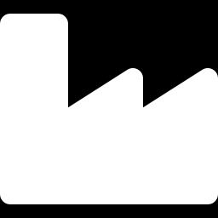
Where Segmentation is Used
APPLICATIONS
Medical Imaging
Autonomous Driving
Tumour & organ delineation in MRI/CT
Road / lane / pedestrian per-pixel map
Satellite & Aerial
Agriculture
Land-use, buildings, deforestation
Crop vs weed; yield estimation
AR & Photo Editing
Industrial QC
Portrait mode, background removal
Defect detection on manufacturing lines
Session 11 | Image Segmentation | Phase 3 — Core CV Tasks

Slide 7
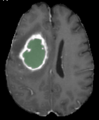
PART 1
Semantic
Segmentation
Per-pixel class labels — FCN & U-Net
Brain MRI — multi-class semantic mask

Slide 8


From Classification CNN to FCN
INTUITION
Standard CNN · Classification
FCN · Fully Convolutional Network
Input
Conv
Conv
Conv
FC
FC
dog
Input
Conv↓
Conv↓
1×1 Conv
Upsample↑
Upsample↑
Mask
Replace FCs with 1×1 conv → encoder shrinks features, decoder upsamples back to image size.
FC layers destroy spatial info — output is one label only.
Key insight: convolutions preserve spatial layout — keep them all the way through.
Session 11 | Image Segmentation | Phase 3 — Core CV Tasks

Slide 9
U-Net Architecture
ENCODER–DECODER + SKIP
← skip connections (concat) →
32×32
68
×68
68
×68
140
×140
140
×140
284
×284
284
×284
572
×572
572
×572
Encoder
Bottleneck
Decoder
Skip connections carry high-resolution detail from encoder → decoder, recovering precise boundaries.
Session 11 | Image Segmentation | Phase 3 — Core CV Tasks

Slide 10
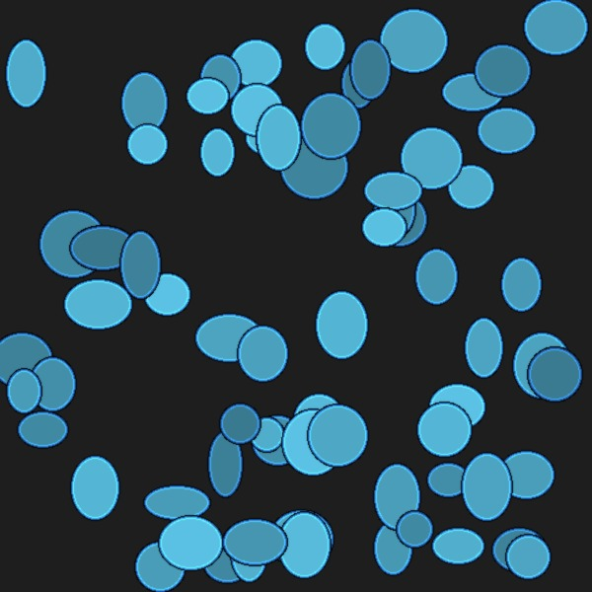
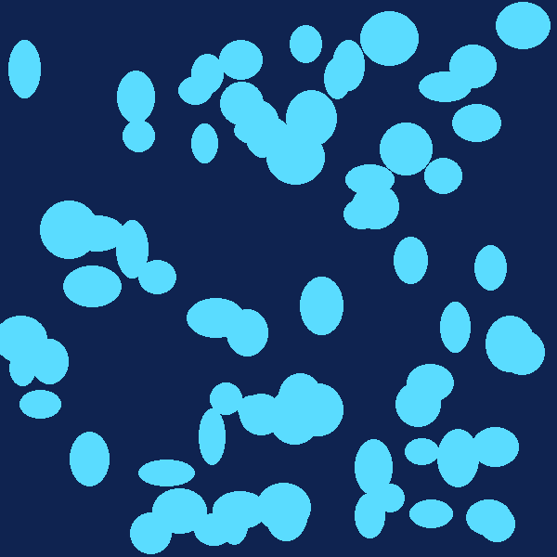
Why U-Net Works
INTUITION + USE CASE
Encoder = WHAT
Classic Use Case · Biomedical Imaging
Deep features capture class identity, but lose location.
U-Net was born in 2015 for cell segmentation (Ronneberger et al.)
Decoder = WHERE
Upsamples step-by-step back to input resolution.
Skips = DETAIL
Direct path for fine edges from encoder to decoder.
INPUT (microscopy)
PREDICTED MASK
Wins ISBI 2015 cell-tracking challenge by a large margin — trained on only 30 images using strong augmentation.
Session 11 | Image Segmentation | Phase 3 — Core CV Tasks

Slide 11
Loss Functions & Metrics
TRAINING & EVAL
LOSSES
METRICS
Cross-Entropy
IoU = |A ∩ B| / |A ∪ B|
Standard per-pixel classification loss.
Dice = 2 · |A ∩ B| / ( |A| + |B| )
A = predicted mask B = ground-truth mask
Dice Loss
Both range 0 → 1. Dice ≈ 2·IoU / (1 + IoU).
Overlap-based — robust to class imbalance.
mIoU
Pixel Accuracy
Focal Loss
Mean IoU over all classes — the gold standard for semantic seg.
Simple correct/total. Misleading when classes are imbalanced.
Down-weights easy pixels — focuses on hard cases.
Combo (CE+Dice)
Pred
Common practical default in medical seg.
Intersection → numerator
Union → denominator
GT
Session 11 | Image Segmentation | Phase 3 — Core CV Tasks

Slide 12
PART 2
Instance
Segmentation
Each object gets its own mask & ID
Per-object masks — Mask R-CNN & YOLOv8-seg

Slide 13
Mask R-CNN — The Idea
TWO-STAGE INSTANCE SEG
Start with: Faster R-CNN
Add: Mask Head
Two-stage object detector you already know:
Small FCN that predicts a binary mask per RoI:
Backbone CNN extracts features
Parallel to the box/class heads
RPN proposes regions of interest
+
Outputs K × m × m masks (one per class)
RoI pooling → fixed-size features
Uses RoIAlign instead of RoIPool (key!)
Heads predict: class + box offset
Trained with per-pixel binary CE loss
Output: bounding boxes + class labels
Output: pixel-perfect mask per object
Mask R-CNN = Faster R-CNN + per-RoI mask branch · He et al., 2017
Session 11 | Image Segmentation | Phase 3 — Core CV Tasks

Slide 14
Mask R-CNN · Architecture Walk-through
PIPELINE
Backbone
(ResNet+FPN)
Region Proposal
Network
RoIAlign
(7×7 / 14×14)
Heads
Why RoIAlign matters
THREE OUTPUT HEADS
RoIPool snaps RoI boundaries to integer feature-map coordinates — fine for boxes, but those quantisation errors shift pixel-perfect masks. RoIAlign uses bilinear interpolation instead, preserving sub-pixel alignment between the RoI and the mask.
Class
Softmax over K+1 classes
BBox
4 offsets per anchor
Mask
K × m × m binary mask
Session 11 | Image Segmentation | Phase 3 — Core CV Tasks

Slide 15
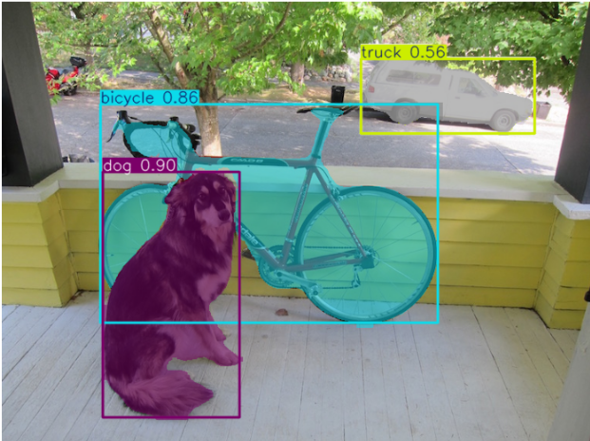
YOLOv8-seg · One-Stage Instance Seg
FAST + UNIFIED
Idea: detection head + prototype masks
Detection result + masks
Inspired by YOLACT — separate the “what” and the “where”:
Backbone + FPN — shared feature extractor
Detection head — predicts boxes + class + k mask coefficients
Prototype branch — produces k full-resolution prototype masks
Combine — Final mask = Σ coef·prototype, cropped by box
dog
0.90
bike
0.86
truck
0.56
End-to-end, one forward pass — far faster than Mask R-CNN.
3 instance masks · inference ~6 ms (yolov8n-seg, GPU)
Session 11 | Image Segmentation | Phase 3 — Core CV Tasks

Slide 16
Mask R-CNN vs YOLOv8-seg
TRADE-OFFS
Aspect | Mask R-CNN | YOLOv8-seg
Approach | Two-stage (detect → mask) | One-stage (joint prediction)
Speed | Slower (~5 fps @ 1024) | Fast (60+ fps @ 640)
Accuracy (COCO) | Higher mask AP | Competitive, slightly lower
Mask quality | Crisp boundaries (RoIAlign) | Good but lower resolution
Training data needs | Moderate | Lower (with augmentation)
Library | detectron2 / mmdetection | ultralytics (one-line API)
Best for | Offline analysis, research | Real-time apps, edge
Rule of thumb: choose Mask R-CNN when accuracy and tooling matter; choose YOLOv8-seg when speed and simplicity win.
Session 11 | Image Segmentation | Phase 3 — Core CV Tasks

Slide 17
Quick Start · Hands-on Today
CODE PREVIEW
YOLOv8-seg · Ultralytics
Mask R-CNN · torchvision
from ultralytics import YOLO
# load pretrained instance-seg model
model = YOLO('yolov8n-seg.pt')
# inference
results = model('dog_bike_car.jpg')
# visualise masks
results[0].show()
# train on custom data
model.train(data='dataset.yaml',
epochs=50, imgsz=640)
import torch, torchvision
from torchvision.models.detection import \
maskrcnn_resnet50_fpn
model = maskrcnn_resnet50_fpn(
weights='DEFAULT').eval()
img = read_image('dog_bike_car.jpg')
pred = model([img / 255.0])[0]
masks = pred['masks'] # N×1×H×W
boxes = pred['boxes']
scores = pred['scores']
Session 11 | Image Segmentation | Phase 3 — Core CV Tasks

Slide 18
Summary & Next Steps
WRAP-UP
WHAT WE COVERED
COMING UP NEXT
Segmentation = per-pixel classification
Session 12 — Keypoint & Pose Estimation
Semantic vs Instance vs Panoptic
MediaPipe + YOLOv8-pose overview
FCN — replace FC with 1×1 conv + upsample
Session 13 — OCR & Text Detection
U-Net — encoder–decoder + skip connections
PaddleOCR / EasyOCR / TrOCR
Loss & metrics: Dice, IoU, mIoU
Mask R-CNN — two-stage with mask head
Practice (this session)
YOLOv8-seg — one-stage, real-time
Notebook: train U-Net on cells + run YOLOv8-seg
Big picture: segmentation moves us from "what's there" to exactly "where" — pixel-perfect.
Session 11 | Image Segmentation | Phase 3 — Core CV Tasks

